Slide 1
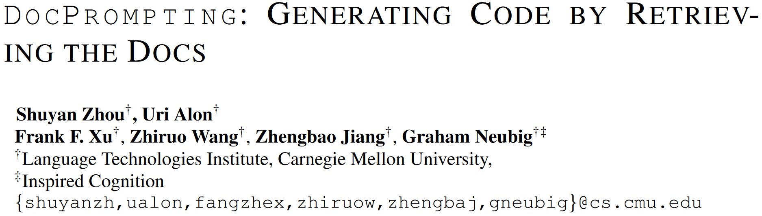
ICLR 2023 under review (6 8 8 8)
arXiv 2207.05987

Slide 2
Abstract
Problem: Existing code models inherently cannot generalize to unseen libraries/APIs, because they never appear in training data.
Motivation: Human developers refer to manuals/docs when using unseen libraries/APIs for the first time.
Our approach (DocPrompting):
Retrieve relevant docs given an NL intent;
Generate code based on the NL intent and retrieved docs.
Improvement:
CodeT5 by 2.85% in pass@1 and 4.39% in pass@10 on CoNaLa (re-split);
CodeT5 and GPT-Neo-1.3B by up to 6.9% EM on tldr (new Bash dataset).

Slide 3
Introduction
Problem:
Implicit assumption: Libraries & APIs were seen in the training data; at test time, the model only needs to generate seen libraries/APIs.
But new libraries/APIs are introduced all the time.
Human solution:
Refer to manuals/docs when writing code.
Our approach:
Retrieve code docs before generating the code.

Slide 4
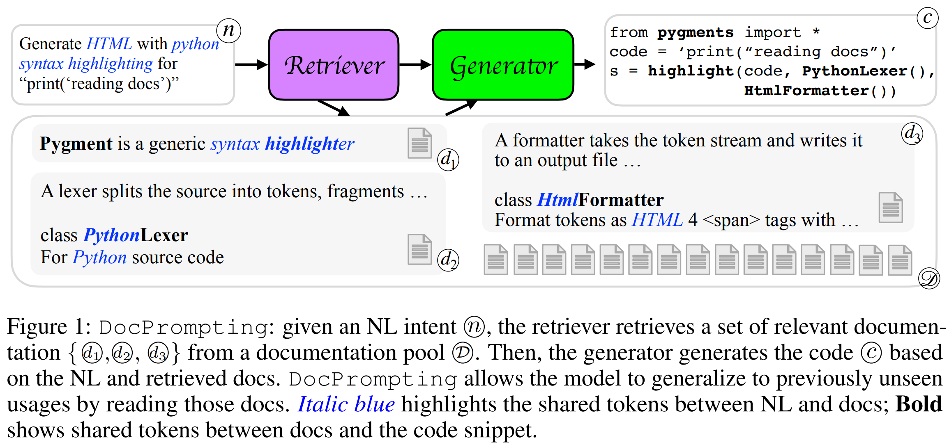
Code Gen by Reading the Docs

Slide 5
Retriever
Sparse retriever: Elasticsearch with BM25.
Dense retriever: Contrastive learning.
Positive (mixed):
NL intent - actually used docs (supervised);
Doc sentences - itself with different dropout (weak supervised).
Negative: other in-batch docs.
Similarity function: cosine similarity.

Slide 6
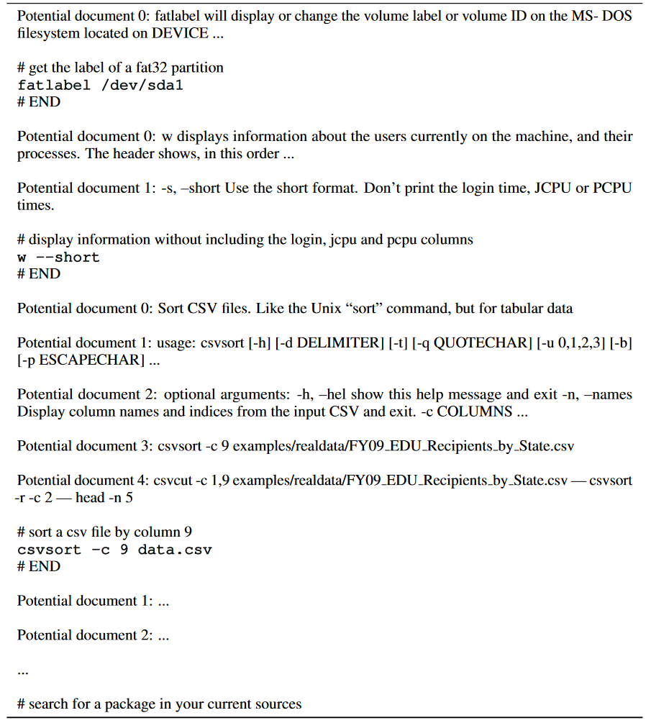
Generator
Input:
Simply concatenate all docs and NL as a single long input;
Fusion-in-Decoder: Concatenate only one doc and NL in one encoder, allow the decoder to attend to all encoded result.
Models:
GPT-Neo-125M, GPT-Neo-1.3B: input a; finetuned.
T5, CodeT5: input b (FiD); finetuned.
Codex (code-davinci-001): input a; 3-shots in-context learning.

Slide 7
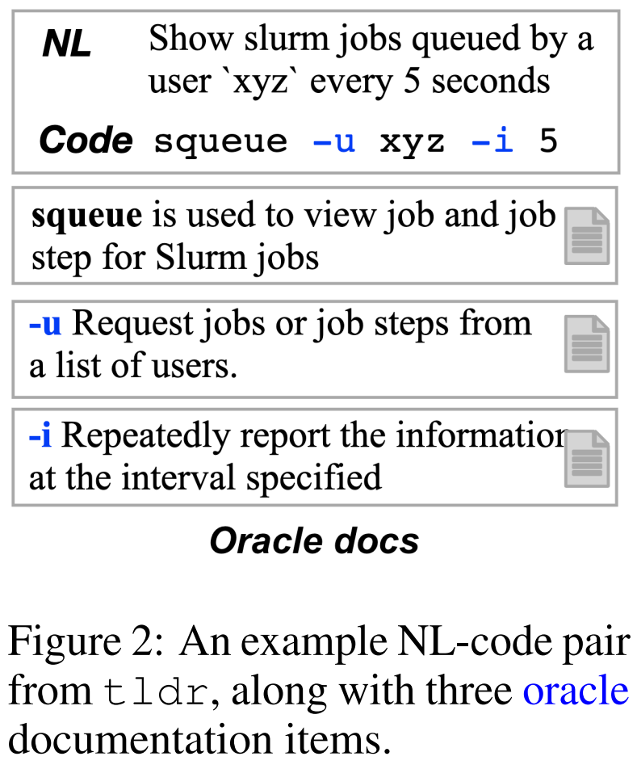
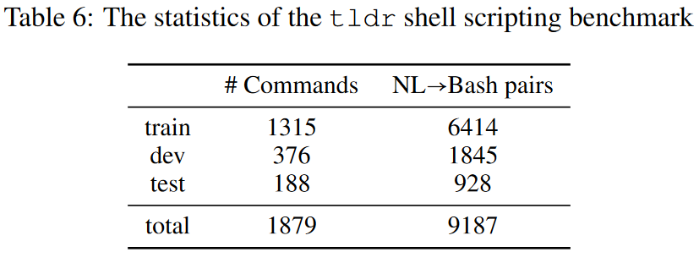
Experimental Setups – tldr dataset (new)
tldr is a community-driven project that maintains easily readable help pages with examples for >2.5k bash commands.
Pool: 400k paragraphs from manuals of commands.
Commands in train, valid, test sets are disjoint.

Slide 8
Experimental Setups – Re-split CoNaLa
Every example in valid and test sets uses at least 1 unseen function.
Answers to the same StackOverflow question is in the same set.
Train/valid/test: 2134/201/543.
Pool: 35763 documents from https://devdocs.io.
Includes built-in libraries and popular libraries such as numpy.
Manually wrote unit tests for 100 examples in test set for pass@k.
Each example has 2.03 tests on average.
Written by two of the authors.

Slide 9
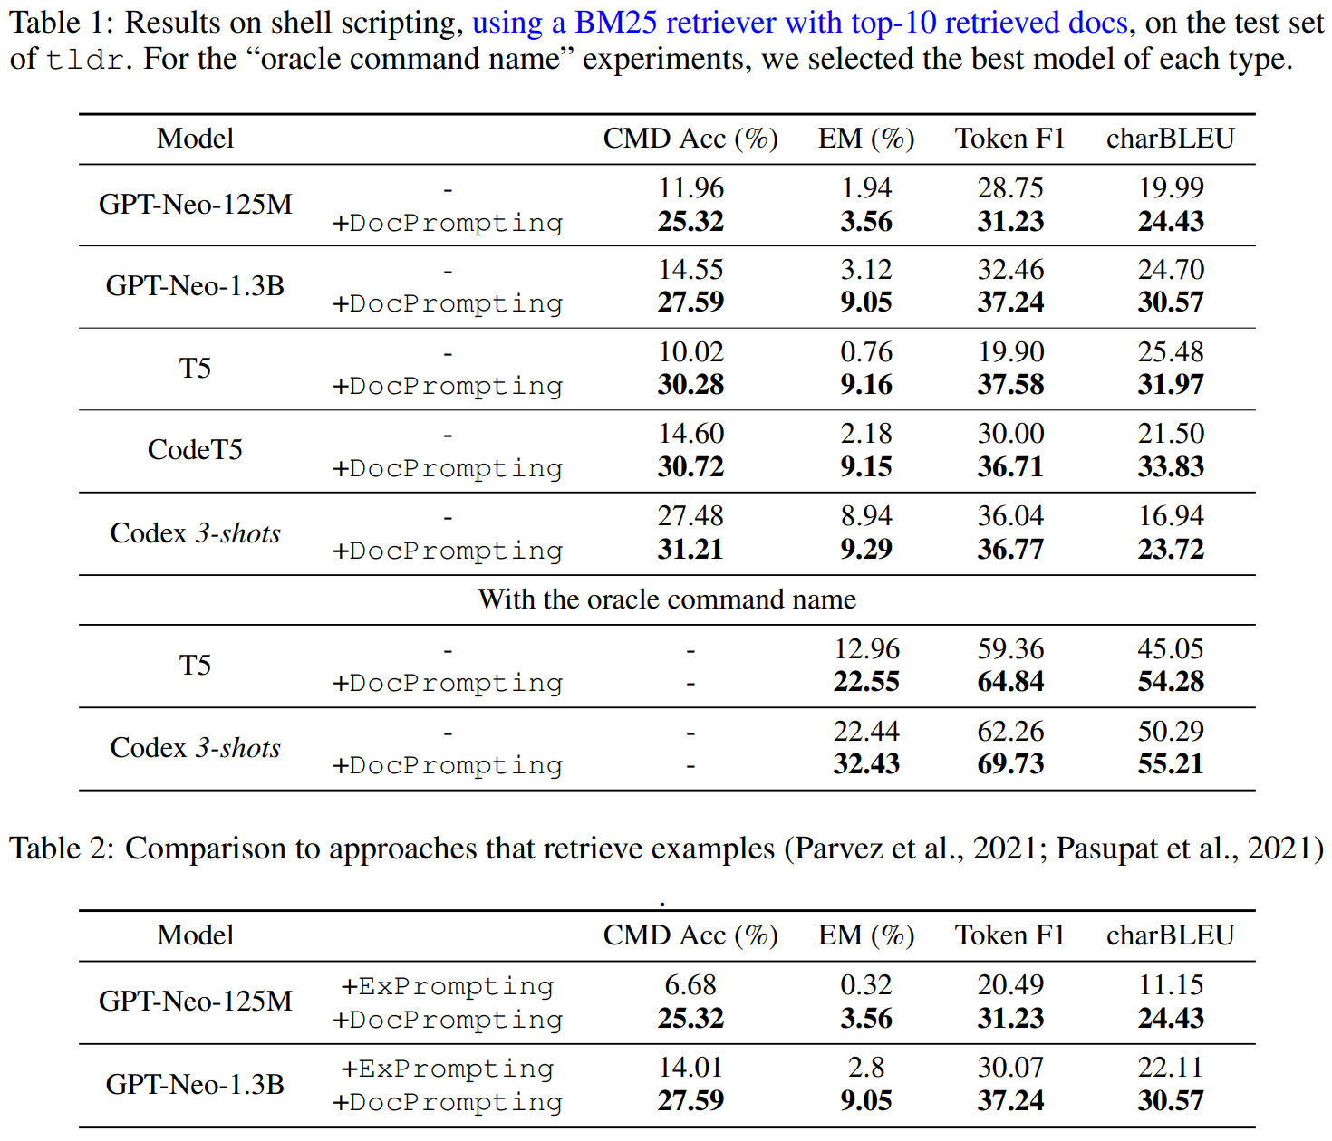
Experimental Results

Slide 10
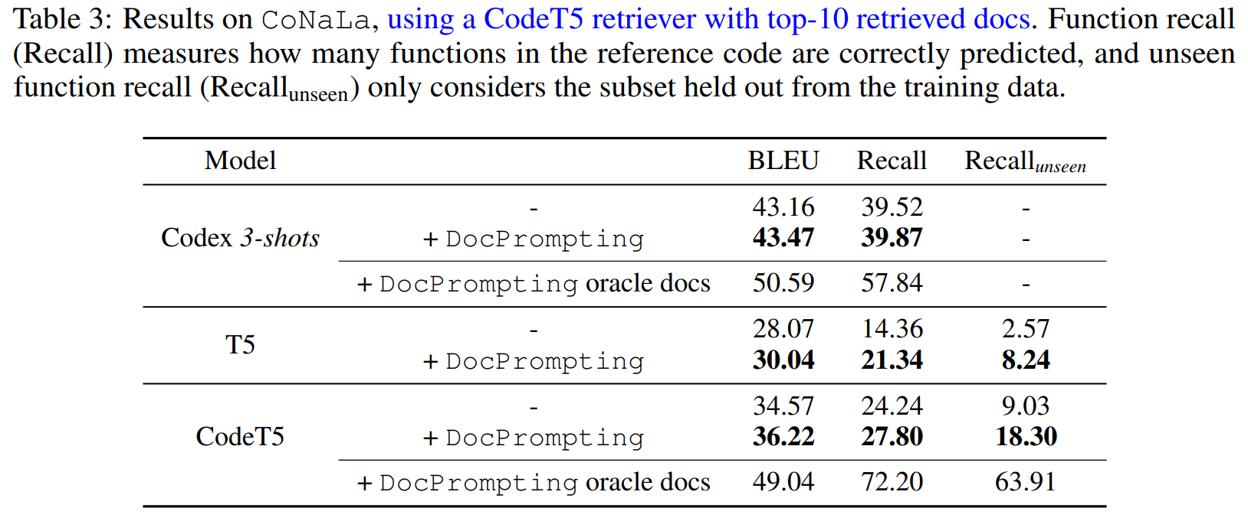
Experimental Results

Slide 11
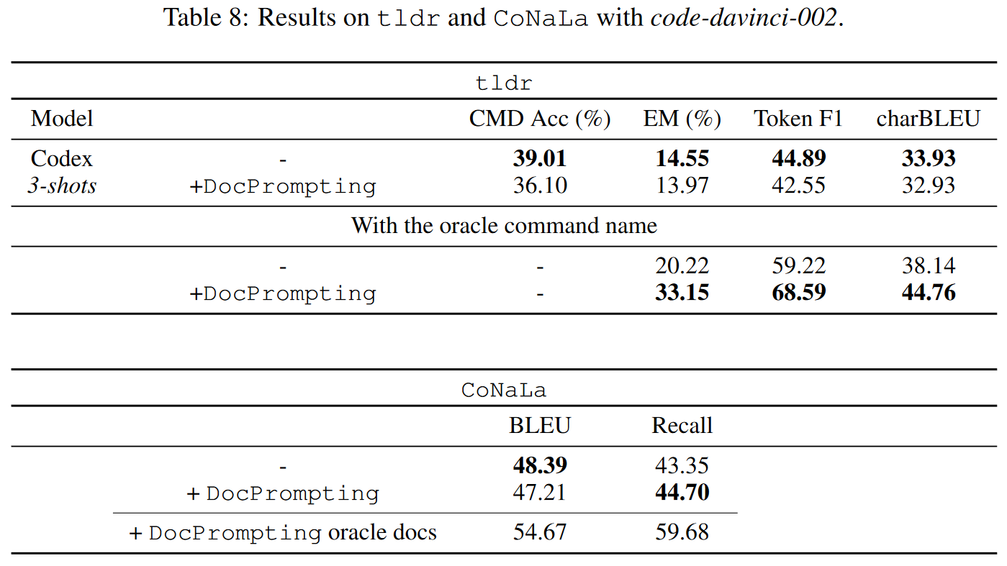
Experimental Results

Slide 12
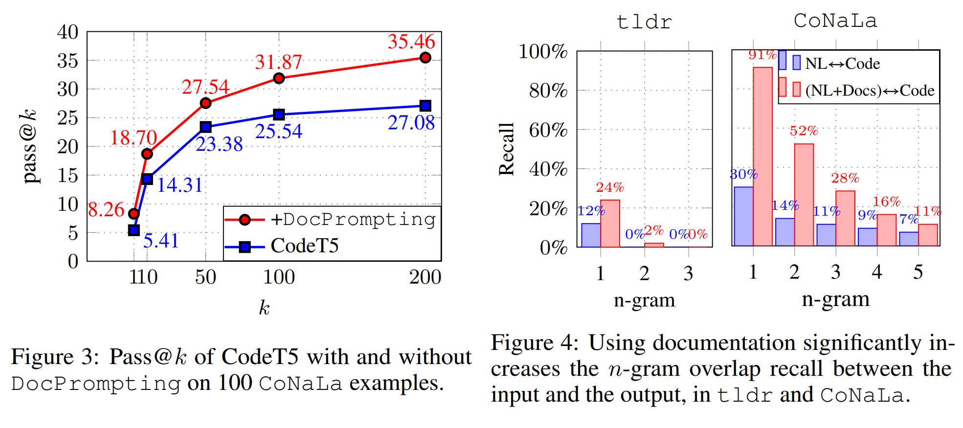
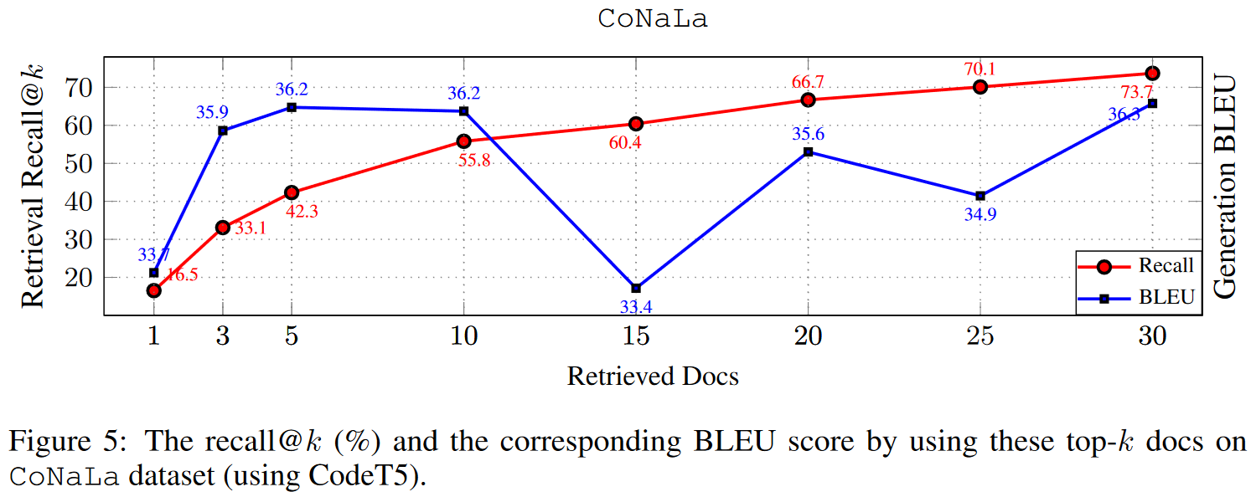
Experimental Results

Slide 13
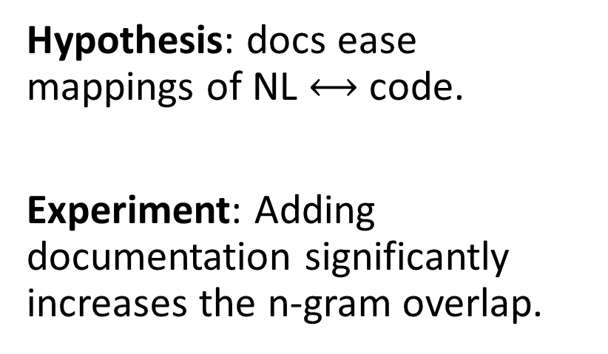
Analysis – Why does it work?
Hypothesis: docs ease mappings of NL $⟷$ code.
Experiment: Adding documentation significantly increases the n-gram overlap.

Slide 14
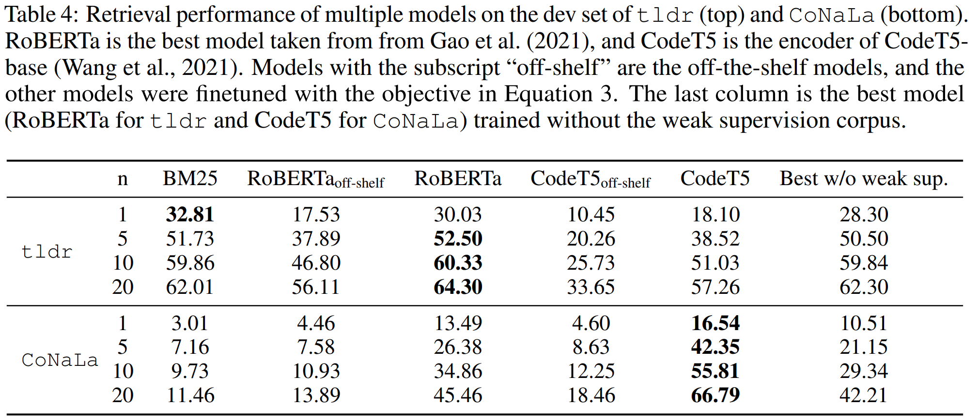
Analysis – Ablation Study

Slide 15
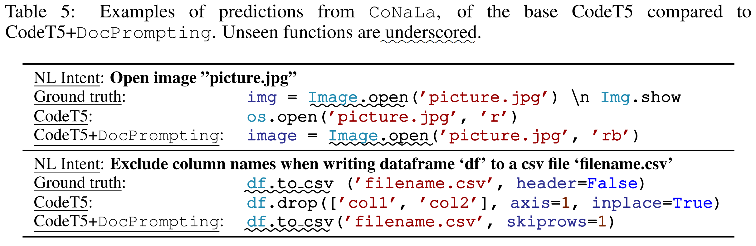
Analysis – Case Study

Slide 16
Conclusion
DocPrompting: a simple and effective approach for code gen by retrieving relevant docs.
Experimental results on 2 datasets show its utility.
2 new datasets proposed in this work.
Good problem, simple idea, good experiments.

Slide 17
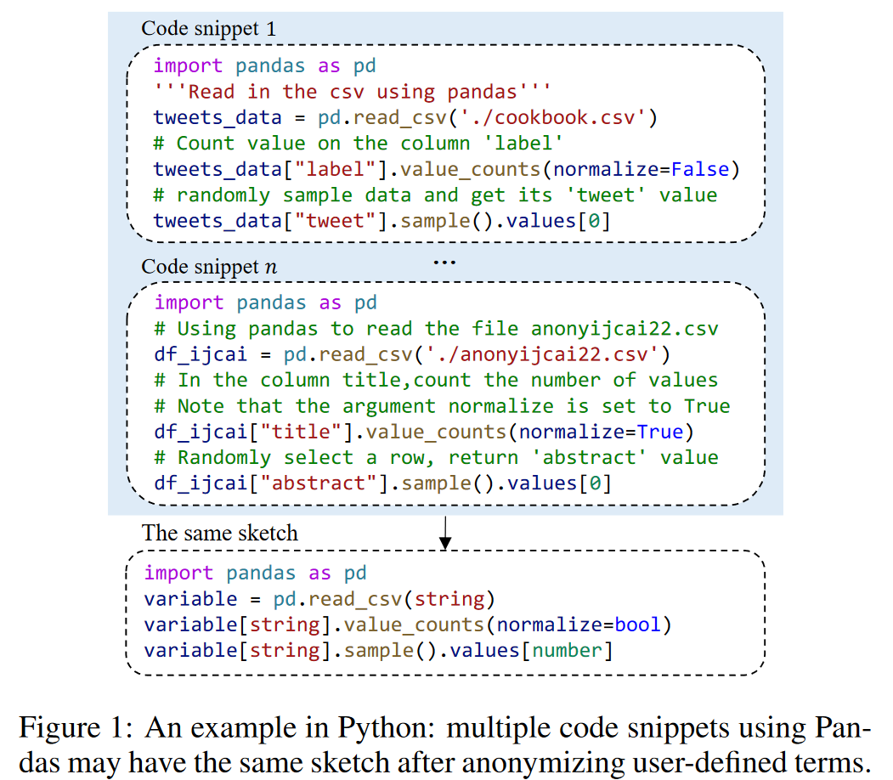
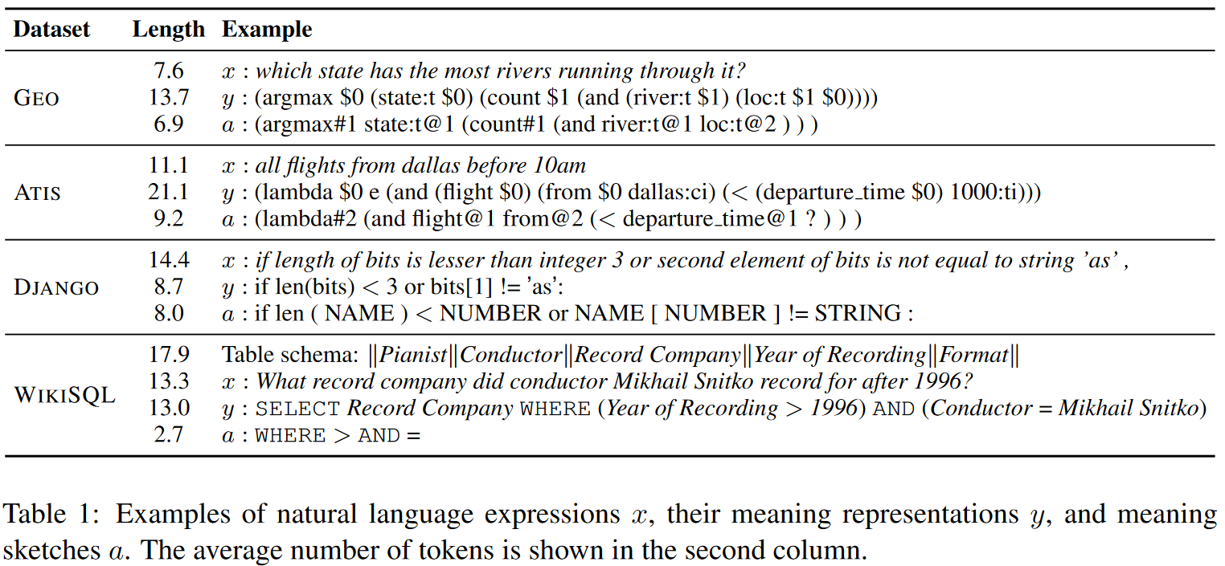
Code Generation Based on Semantic Sketch
NL => sketch => code
Generate important content first!
CERT: Continual Pre-Training on Sketches for Library-Oriented Code Generation (IJCAI'22)
Coarse-to-Fine Decoding for Neural Semantic Parsing (ACL'18)
Notes:
写代码时已经先想好了那些重要的部分，细节是写代码时补充的

Slide 18
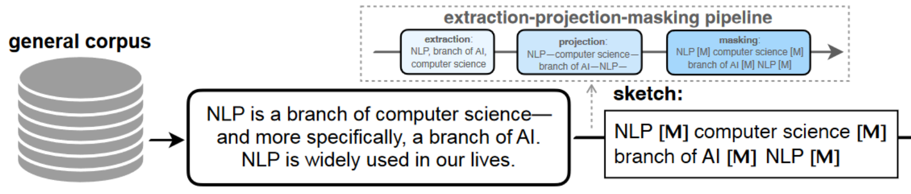
Code Generation Based on Semantic Sketch
Sketch-based generation depends on hand-crafted sketch-generation algorithms.
Use neural models to generate sketch?
Unsupervised keyword extraction.
Unsupervised summarization.

Slide 19
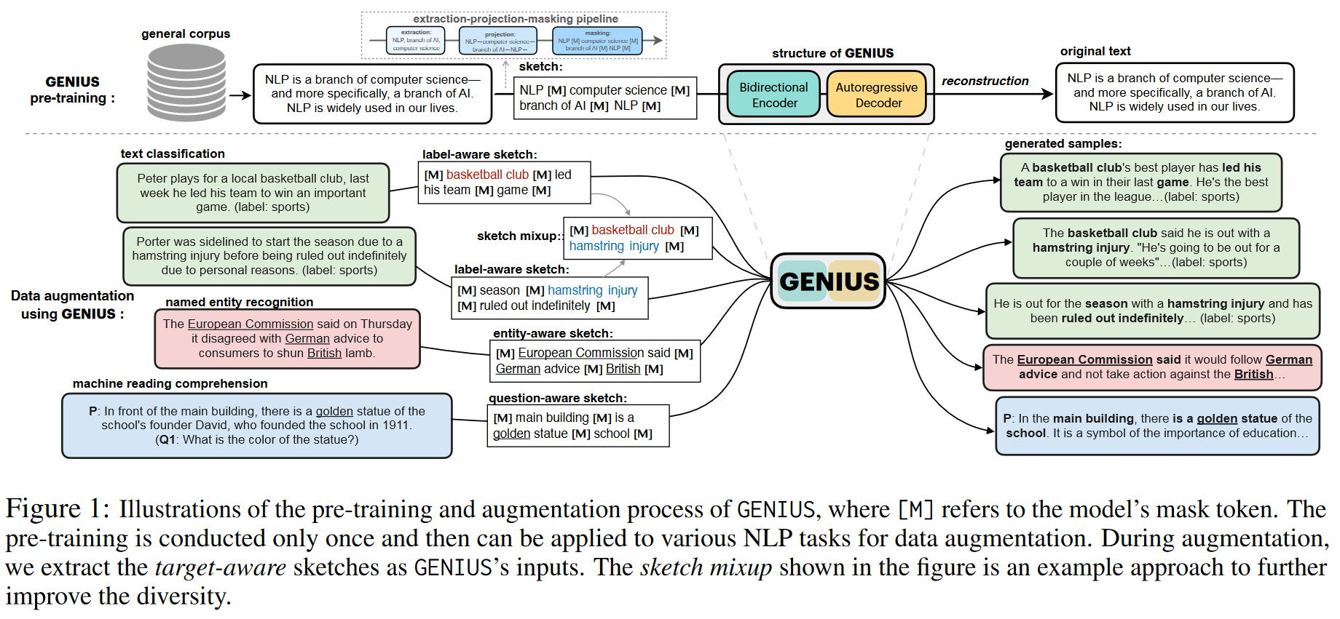
Related work in NLP
GENIUS: Sketch-based Language Model Pre-training via Extreme and Selective Masking for Text Generation and Augmentation (arXiv 2211.10330)

